Slide 1


A Major Project Presentation on Revolutionizing Leaf Disease Detection with Edge Computing and Deep Learning in Partial Fulfillment for BTech Computer Engineering (Regional Language) Course- Major Project Under the guidance of Prof. Rucha Shinde Department of Computer Engineering (Regional Language) PCET’s Pimpri Chinchwad College of Engineering
Rinku Sonawane | 122B2D069
Onkar Dokhe | 122B2D072
Vipul Waikar | 122B2D073
Omkar Garvare | 122B2D074

Slide 2
Contents
Introduction
Problem Definition
Motivation
Objective
Literature Survey
Software Requirement Specification
Algorithm
Dataset
Proposed System
Project Plan
Software Testing
Results
Contribution to Sustainable Development Goals
Future Scope
Conclusion
References

Slide 3
Introduction
This project presents a smart plant disease detection system designed to identify diseases in crop leaves using advanced image processing and deep learning techniques. The system leverages a VGG-19-based Convolutional Neural Network (CNN) trained on a diverse dataset of plant leaf images representing healthy and diseased conditions.
Users can upload or capture an image of a leaf, and the system instantly analyzes it to detect the disease type with high accuracy. The platform is integrated with a MongoDB database to store disease information, prediction history, and multilingual descriptions for user accessibility.
Key features include real-time detection via camera, audio output of disease information in English and Marathi using Google Text-to-Speech, and a responsive FastAPI-powered backend for efficient performance and integration.

Slide 4
Problem Definition
Plant diseases cause major losses in agriculture, and traditional diagnosis methods are slow, require expert knowledge, and are not accessible to all farmers. This project aims to automate plant leaf disease detection using deep learning to provide fast, accurate, and reliable solutions, helping farmers take timely actions for better crop management.

Slide 5
Motivation
Disease Diagnosis: The proposed system aims to provide accurate and automated detection of plant leaf diseases, reducing the dependency on manual inspection and expert intervention.
Real world problem with interactive UI: With voice output and regional language support, the system is accessible to farmers in rural areas, including those with limited literacy or technical expertise.
Such a system can have far-reaching positive effects, from improving crop health and yield to reducing pesticide misuse and supporting sustainable agriculture.

Slide 6
Objectives
To build the capability of accurately detecting plant leaf diseases using deep learning techniques.
To improve model performance by training on a well-augmented dataset using various CNN architectures like VGG19, MobileNet, and ResNet.
To develop a robust disease detection system integrated with voice output and regional language support for wider accessibility.
To design a computationally efficient model suitable for real-time use on mobile or edge devices.

Slide 7
Deep Learning Based Methods
Literature Review
Sr No | Title | Year | Methodology | Strengths | Weakness
1 | Vision Based Detection and Classification of Disease on Rice Crops Using Convolutional Neural Network | 2019 | A CNN-based approach trained on a large dataset of healthy and diseased rice leaves to detect and classify various rice plant diseases. | Achieved high accuracy in identifying multiple rice crop diseases using deep learning | Limited to rice crop dataset; lacks crosscrop generalization.
2 | Detection of Disease in Cotton Leaf using Artificial Neural Network | 2019 | Used ANN trained on extracted image features from cotton leaf datasets to detect diseases. | Satisfactory accuracy achieved; efficient feature-based classification. | Only ANNbased approach used; not compared with deep learning models.

Slide 8
Machine Learning Based Methods
Literature Review
Sr No. | Title | Year | Methodology | Strengths | Weakness
3 | Leaf Disease Detection: Feature Extraction with K-means Clustering and Classification with ANN | 2020 | A two-step model using K-means for feature extraction and ANN for classification. | Improved efficiency and accuracy due to hybrid technique. Performance limited by basic clustering and manual feature extraction. | Performance limited by basic clustering and manual feature extraction.
4 | Image Based Plant Disease Detection in Pomegranate Plant for Bacterial Blight | 2020 | Utilized image processing and machine learning techniques for disease classification in pomegranate plants. | Effective in detecting bacterial blight; demonstrated image-based model applicability. | Model is focused only on one disease and crop.

Slide 9
Deep Learning Based Methods
Literature Review
Sr No. | Title | Year | Methodology | Strengths | Weakness
5 | Fast and Accurate Detection and Classification of Plant Diseases | 2019 | Applied image processing, feature extraction, and ML algorithms on digital plant images for classification. | High-speed and accurate detection demonstrated using basic image analysis techniques. | Older techniques; lacks integration of deep learning approaches

Slide 10
Sr No | Title | Year | Methodology | Strengths | Weakness
6 | Disease Detection in Coffee Plants Using Convolutional Neural Network | 2020 | CNN model trained on coffee plant images for disease classification and detection. | Achieved significant accuracy; demonstrated CNN effectiveness in agriculture. | Datasetspecific model; no evaluation across diverse datasets.
7 | Textural Features for Image Classification | 2019 | Proposed statistical texture-based features (e.g., GLCM) for classifying images. | Pioneering work in texture analysis; foundation for many image processing applications. | Classical method; not aligned with current deep learning trends.

Slide 11
Software Requirement Specification
1) Functional Requirements
- Allow users to upload leaf images for disease detection.
- Enable real-time disease detection using webcam input.
- Fetch disease-related details (name, symptoms, treatment) from MongoDB Atlas.
- Provide text-to-speech output in English and Marathi.
- Generate and allow download of disease detection reports.
- Support a multi-language user interface.
- Use a FastAPI-based backend to handle API requests and model predictions.

Slide 12
Software Requirement Specification
2) Non-Functional Requirements
- Ensure fast and responsive real-time disease prediction.
- Maintain high accuracy in classification across multiple plant disease types.
- Use a scalable and low-latency database for efficient data retrieval.
- Provide a user-friendly interface with support for multiple languages.
- Ensure secure, reliable, and private access to backend data.

Slide 13
Software Requirement Specification
Software Requirements:
The software components utilized in this project are as follows:
Programming Language: Python
Deep Learning Framework: TensorFlow/Keras (specifically for the VGG-19 model)
Computer Vision Library: OpenCV (for webcam integration)
Backend Framework: Flask (for server-side operations)
Database Integration: PyMongo (for interfacing with MongoDB)
Text-to-Speech Libraries: gTTS and pyttsx3 (for voice output functionality)

Slide 14
Algorithm
Step 1: Data Preparation - Collect and preprocess plant images.
Step 2: Feature Extraction - Extract features using VGG19.
Step 3: Model Selection - Fine-tune VGG-based models.
Step 4: Model Training - Train and validate using transfer learning.
Step 5: Testing - Test accuracy (image, voice, language).
Step 6: Classification - Identify plant species.

Slide 15
Dataset
Medicinal Leaf Dataset :
Appropriate datasets are required at all stages of content-based images retrieval
research , starting from the training phase to the detection phase to evaluate the
performance of the algorithm . All the images collected from the data sets were
downloaded from https://www.kaggle.com/datasets/arjuntejaswi/plant-village
Trainable | Non-Trainable | TOTAL
6300 | 1500 | 7800

Slide 16
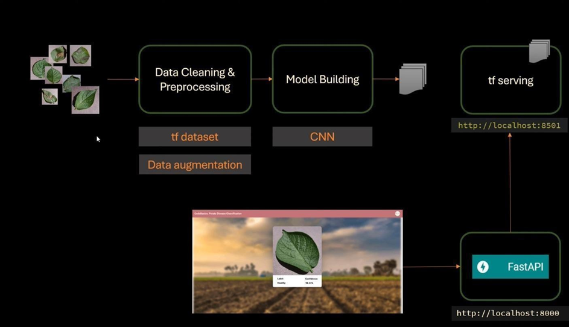
Proposed System
Fig.1: Flowchart

Slide 17
Project Plan
Component | Specification | Estimated Monthly Cost (INR)
Processing Power | GPU-enabled system (e.g., NVIDIA RTX 3060/3080) | ₹8,000 – ₹12,000
RAM/Memory | 16 GB DDR4 RAM or above | ₹1,800 – ₹3,000
Storage | 512 GB SSD for fast image loading/training | ₹1,200 – ₹1,800
Internet/Network | High-speed internet for dataset/API usage | ₹1,000 – ₹2,000
Project Cost Estimation

Slide 18
Software Testing
1) Unit Testing
Test Case ID | Module/Feature | Test Description | Input | Expected Output | Status
UT01 | Login | Valid login | user@example.com / 123456 | Redirect to dashboard | Pass
UT02 | Login | Invalid login | wrong@example.com / 0000 | Show 'Invalid Credentials' | Pass
UT03 | Image Upload | Valid image format | Upload tomato disease.jpg | Image accepted | Pass
UT04 | Image Upload | Unsupported file type | Upload tomato disease.pdf | Show 'Invalid file type' | Pass
UT05 | CNN Prediction | Check prediction logic | Valid leaf image | Predicted class label shown | Pass
UT06 | Audio Module | Validate audio playback | Click 'Play' on description | Audio plays successfully | Pass
UT07 | Logout | Validate logout functionality | Click on logout | Redirect to login page | Pass

Slide 19
Software Testing
2) Integration Testing
Test Case ID | Module/Feature | Test Description | Input | Expected Output | Status
IT01 | Login + Dashboard | Check login flow | Login | Dashboard loads | Pass
IT02 | Upload + Prediction | Upload image and get result | Upload image | Plant name appears | Pass
IT03 | Prediction + Info Display | Check prediction info | Upload → Predict | Correct plant details | Pass
IT04 | Info + Audio | Verify audio for plant | Click play | Audio plays plant info | Pass

Slide 20
Software Testing
3) Acceptance Testing
Test Case ID | Module/Feature | Test Description | Input | Expected Output | Status
AT01 | Image to Plant Mapping | Upload leaf and check result | Upload leaf image | Correct plant disease name | Pass
AT02 | Audio Feature | Click 'Play' | Click on Play | Audio plays | Pass
AT03 | Multilingual Support | Switch to Marathi | Select Marathi | Info in Marathi | Pass

Slide 21
Software Testing
4) Regression Testing
Test Case ID | Module/Feature | Test Description | Input | Expected Output | Status
RG01 | Login | Blank login check | Submit empty fields | Validation message | Pass
RG02 | CNN | Blurred image handling | Upload blurred image | Low confidence warning | Pass
RG03 | Audio | Marathi audio | Play in Marathi | Marathi audio heard | Pass
RG04 | Upload | Large file crash | Upload 10MB image | Size limit warning | Pass

Slide 22
Software Testing
5) System Testing
Test Case ID | Module/Feature | Test Description | Input | Expected Output | Status
ST01 | End-to-End Flow | Complete plant detection flow | Login → Upload → Predict | Plant details + Audio + Dashboard | Pass
ST02 | File Upload & Validation | Check image type and size | Upload JPG < 5MB | Image accepted | Pass
ST03 | Prediction & Accuracy | Validate model prediction | Leaf image of Tulsi | Correct plant name shown | Pass
ST04 | Multilingual Flow | Check regional language output | Select Marathi → Predict | Info in Marathi displayed | Pass

Slide 23
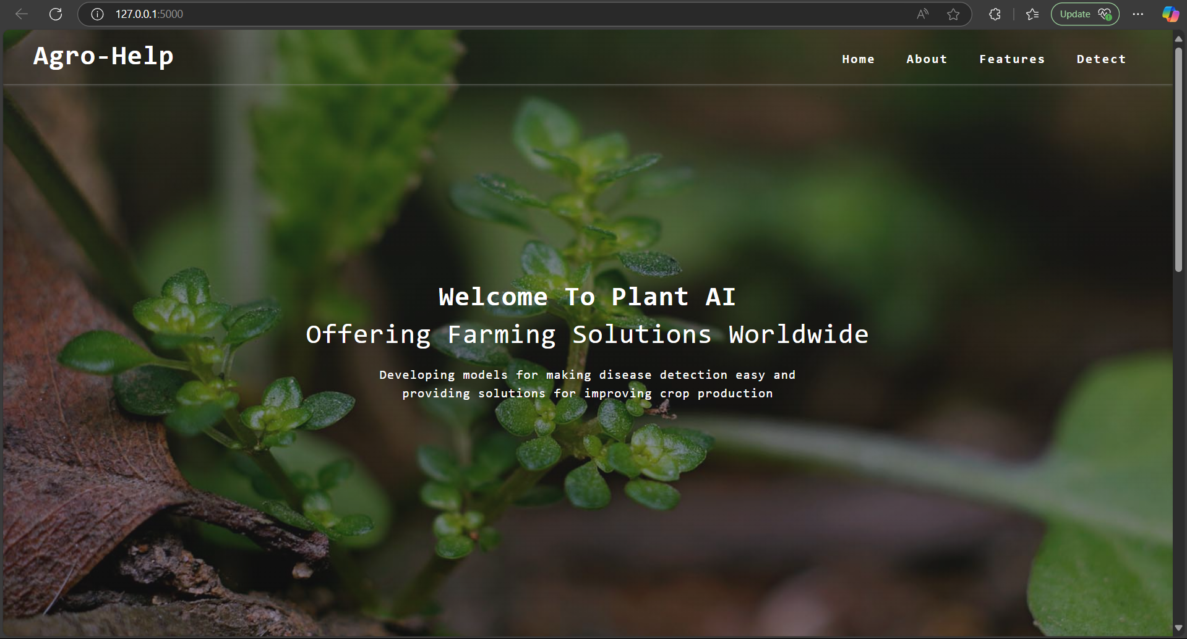
Results
Output of images shown in browser for Home Page

Slide 24
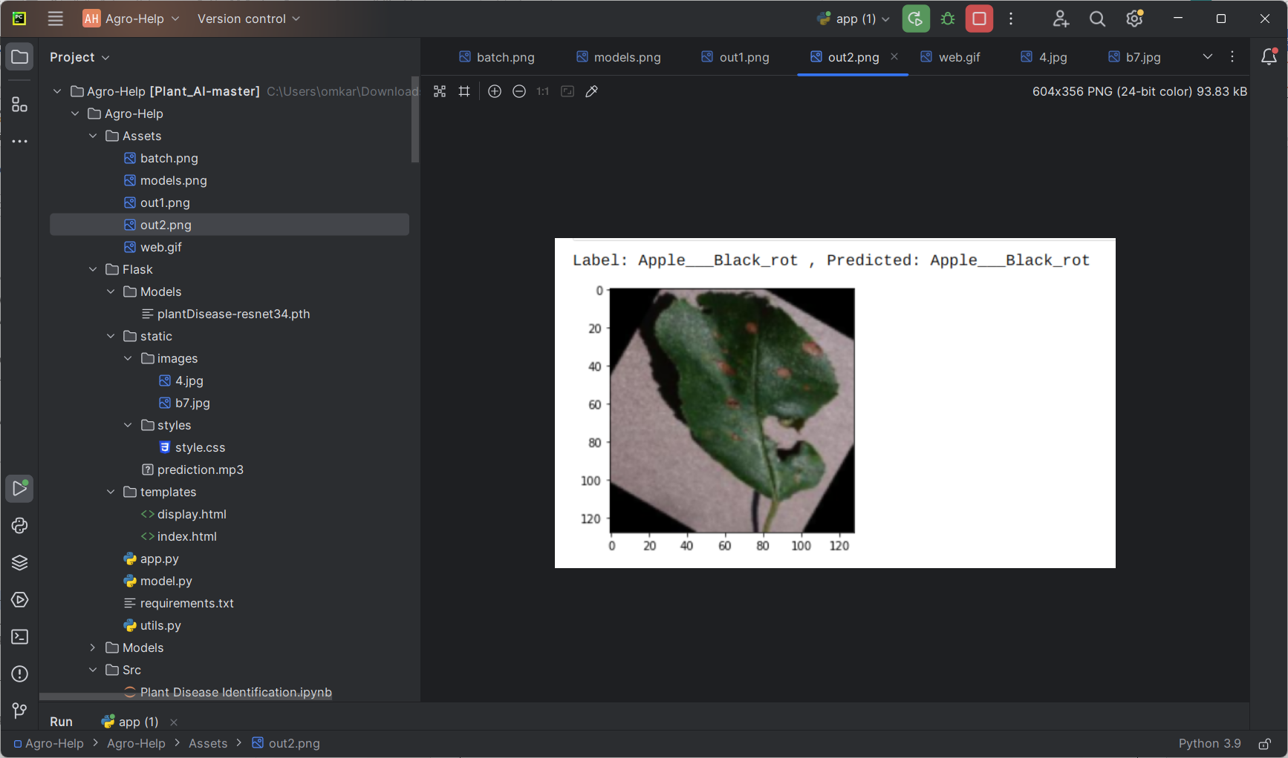
Results
Fig.3: Dataset Leaf

Slide 25
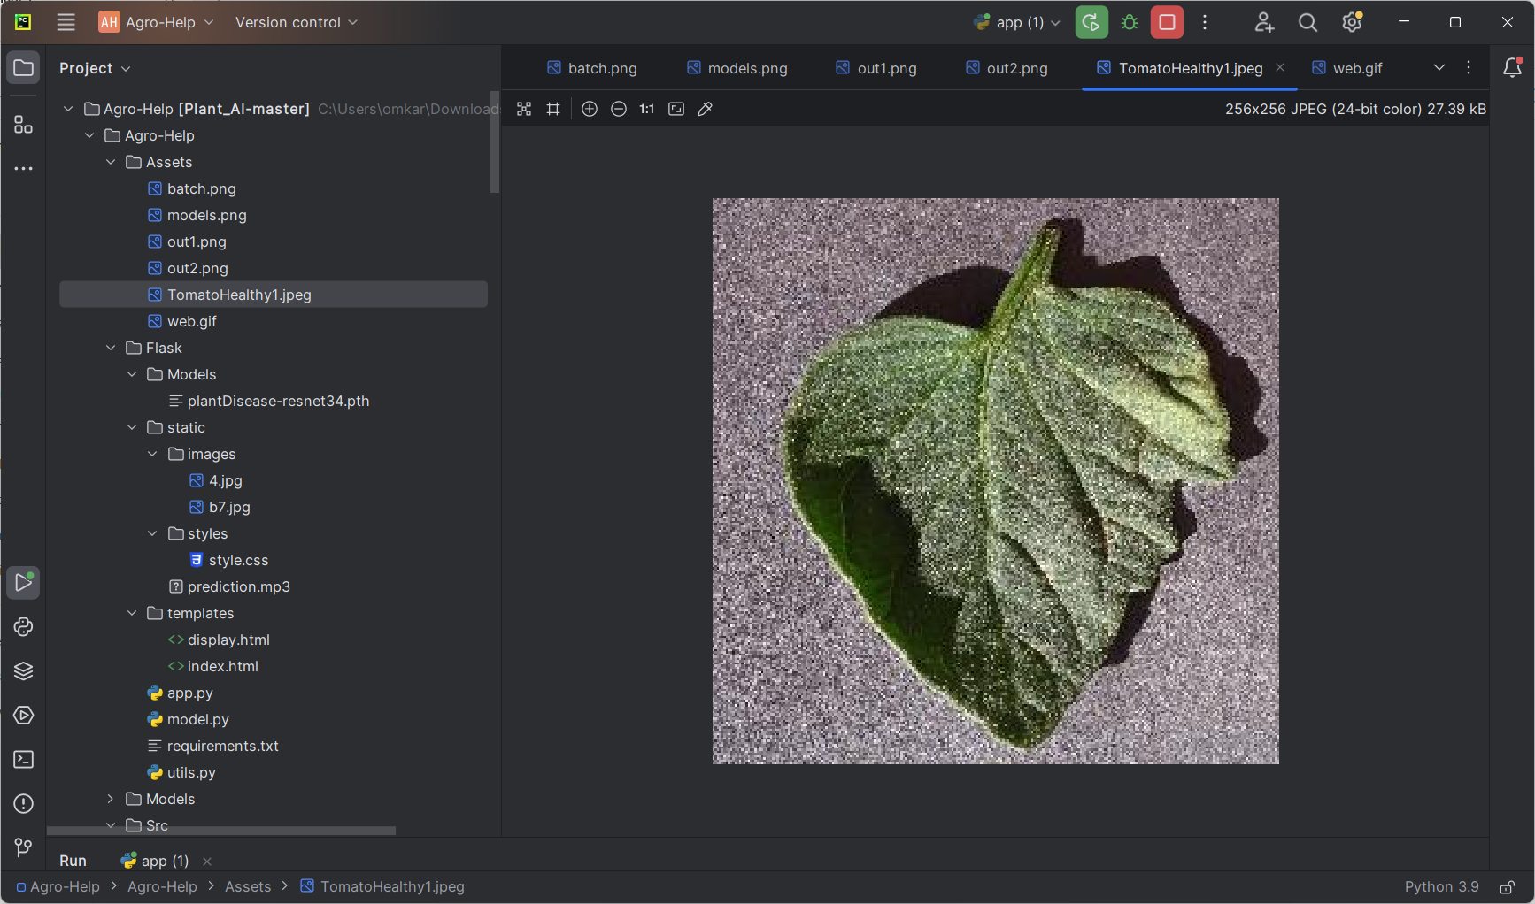
Results
Fig.3: Healthy Leaf

Slide 26
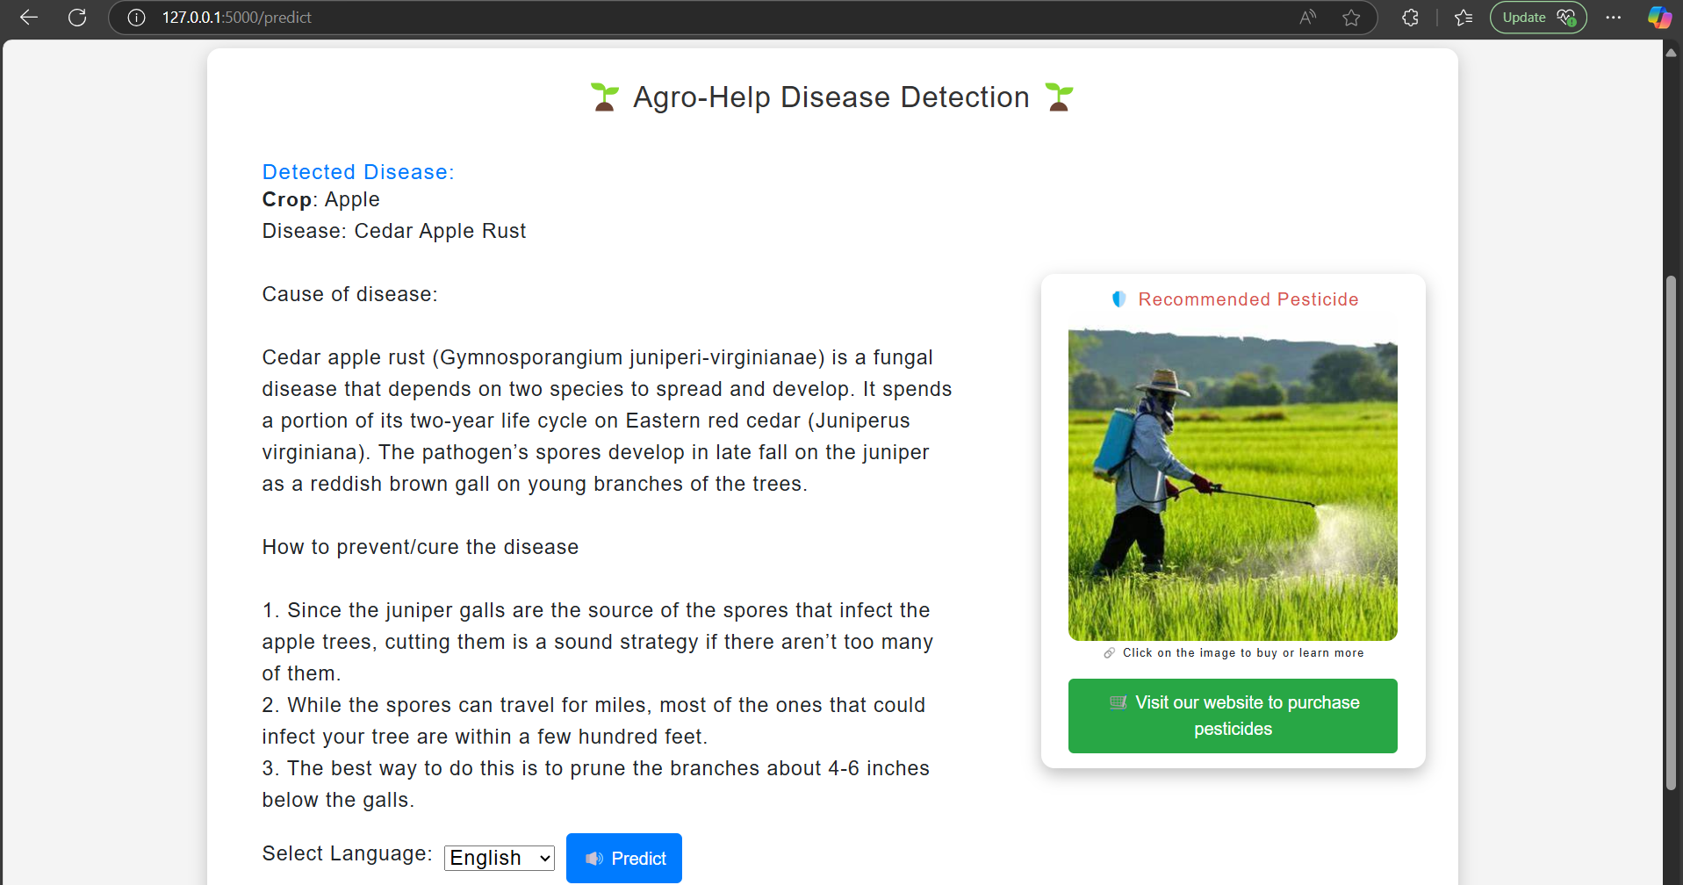
Results

Slide 27
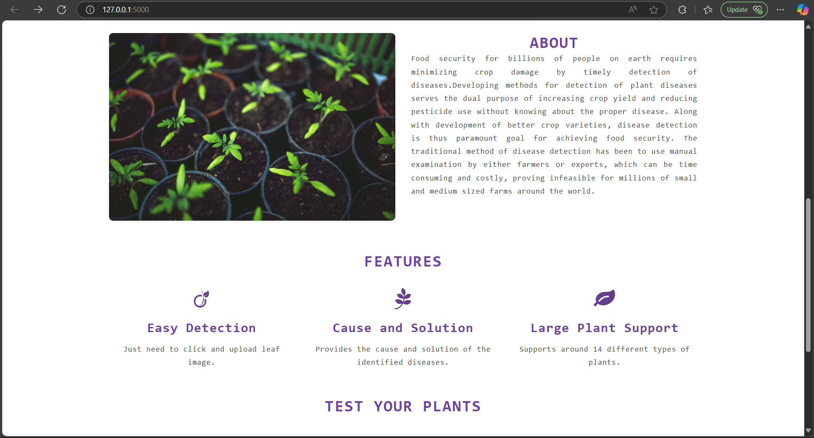
Results

Slide 28
Contribution to Sustainable Development Goals
Enhances agricultural productivity by enabling the early and accurate detection of plant diseases
Promotes sustainable agricultural practices by reducing the need for excessive use of pesticides through timely and targeted intervention.
Fosters innovation in agriculture through the development and application of advanced technologies like deep learning
Contributes to environmental sustainability by minimizing the negative impact of plant diseases on crop health and reducing chemical usage.
Supports economic sustainability by providing farmers with a cost-effective and efficient tool to protect their crops and livelihoods.
Encourages the adoption of technology in the agricultural sector, driving progress towards sustainable development and resilient agricultural systems.

Slide 29
Future Goals
Refinement of Deep Learning Models: Future iterations aim to fine-tune the current VGG 19 model and explore more efficient architectures such as ResNet or EfficientNet to improve performance and reduce inference time.
Larger and Diverse Dataset: Expanding the dataset with high-quality images captured under various conditions will improve model generalization and robustness.
Inclusion of Rare Species: Collaborating with botanical experts and herbal research institutions to include rare or endangered medicinal plants will add significant value to the system.
Support for Regional Languages: Enhancing the voice recognition system to support multiple Indian and global languages will ensure broader accessibility.

Slide 30
Conclusion
In conclusion, the Plant Leaf Disease Detection project successfully developed a deep learning system for automated plant disease identification. This system helps farmers quickly and accurately identify diseases, enabling better crop management and higher yields. The project used techniques like image processing and deep learning, achieving an overall accuracy of 99%. This success is attributed to the effective use of tools and technologies such as Jupyter Notebook, Python IDEs, and FastAPI. The results demonstrate the potential of deep learning for automated plant disease identification and its value for improving crop management.

Slide 31
References
1. Haseeb Nazki, Sook Yoon, Alvaro Fuentes, Dong Sun Park “Unsupervised image translation using adversarial networks for improved plant disease recognition” Published by Elsevier B.V,(2020).
2. Shanwen Zhang, Subing Zhang, Chuanlei Zhang, Xianfeng Wang, Yun Shi “Cucumber leaf disease identification with global pooling dilated convolutional neural network” Published by Elsevier B.V, (2019).
3. Uday Pratap Singh, Siddharth Singh Chouhan, Sukirty Jain, And Sanjeev Jain “Multilayer Convolution Neural Network for the Classification of Mango Leaves Infected by Anthracnose Disease” (2019).
4. Vijai Singh “Sunflower leaf diseases detection using image segmentation based on particle swarm optimization” 2019 Published by Elsevier,(2019).
5. Sumita Mishra, Rishabh Sachan, Diksha Rajpal “Deep Convolutional Neural Network based Detection System for Real-time Corn Plant Disease Recognition” 2020 Published by Elsevier B.V, (2019).

Slide 32
6. Parul Sharma, Yash Paul Singh Berwal , Wiqas Ghai “Performance analysis of deep learning CNN models for disease detection in plants using image segmentation” open access 2019 Published by Elsevier B.V, (2019). 7. Mohit Agarwal, Abhishek Singh, Siddhartha Arjaria, Amit Sinha, Suneet Gupta “Tamato Leaf Disease Detection using Convolution Neural Network” 2019-2020 Published by Elsevier,(2019). 8. Aditya Khamparia, Gurinder Saini, Deepak Gupta, Ashish Khanna, Shrasti Tiwari, Victor Hugo C. de Albuquerque “Seasonal Crops Disease Prediction and Classification Using Deep Convolutional Encoder Network” ,(2019). 9. Srdjan Sladojevic, Marko Arsenovic, Andras Anderla, Dubravko Culibrk and Darko Stefanovic “Deep Neural Networks Based Recognition of Plant Diseases by Leaf Image Classification”, Volume 2016 Hindawi Publishing Corporation,(2016). 10. Majji V Applalanaidu, G. Kumaravelan “A Review of Machine Learning Approaches in Plant Leaf Disease Detection and Classification” IEEE,(2021).

Slide 33
THANK YOU !!!!

